Slide 1
CronJob
Module-10

Slide 2
Contents
CronJob Overview

Slide 3
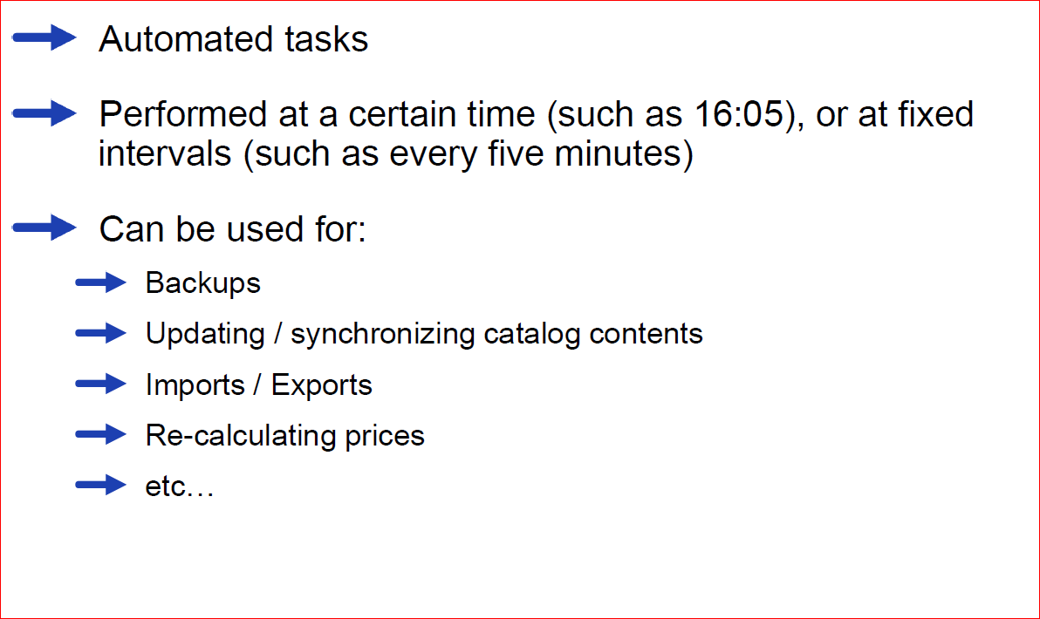
CronJobs – Key Facts

Slide 4
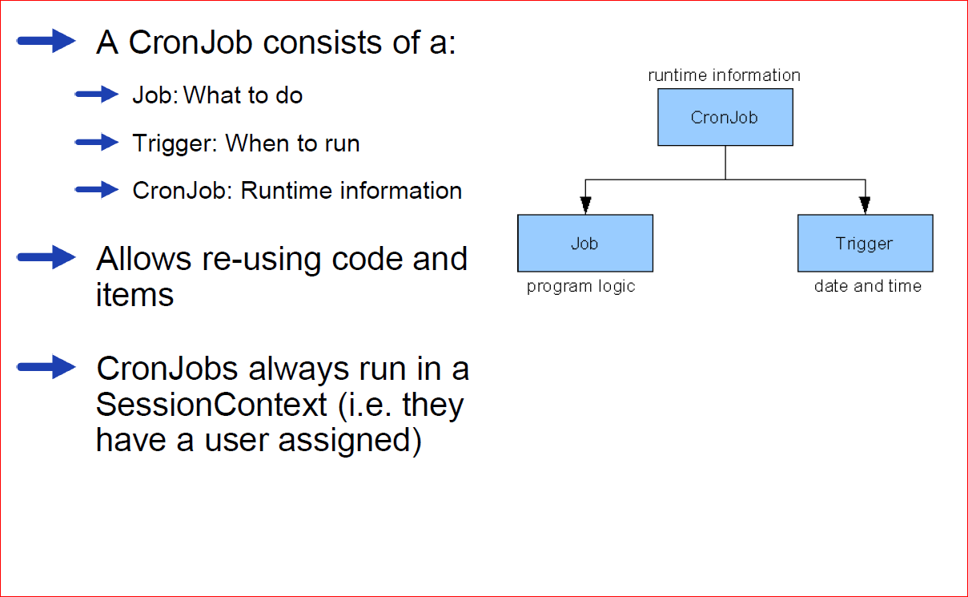
CronJobs – Key Facts (2)

Slide 5
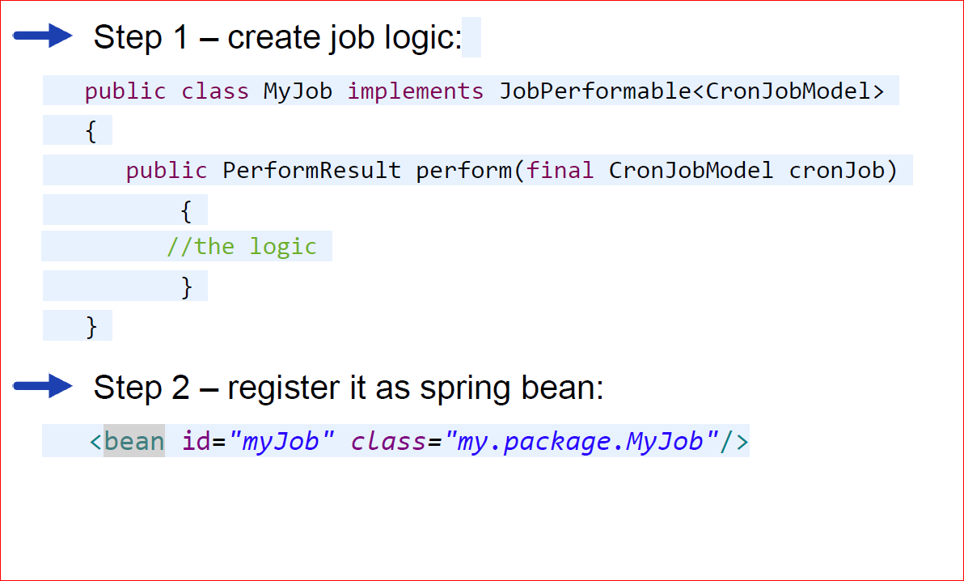
How to create a CronJob

Slide 6
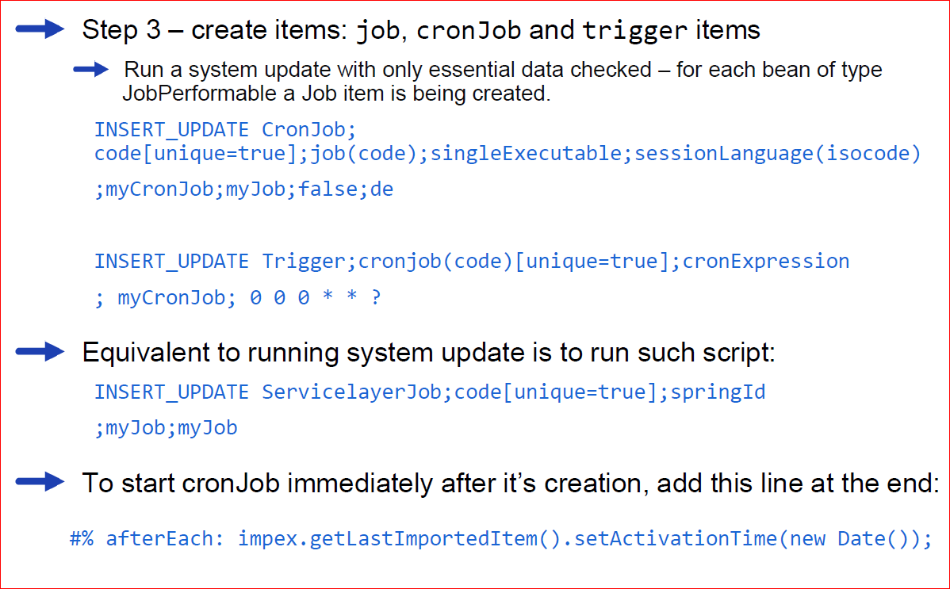
How to create a CronJob (2)

Slide 7
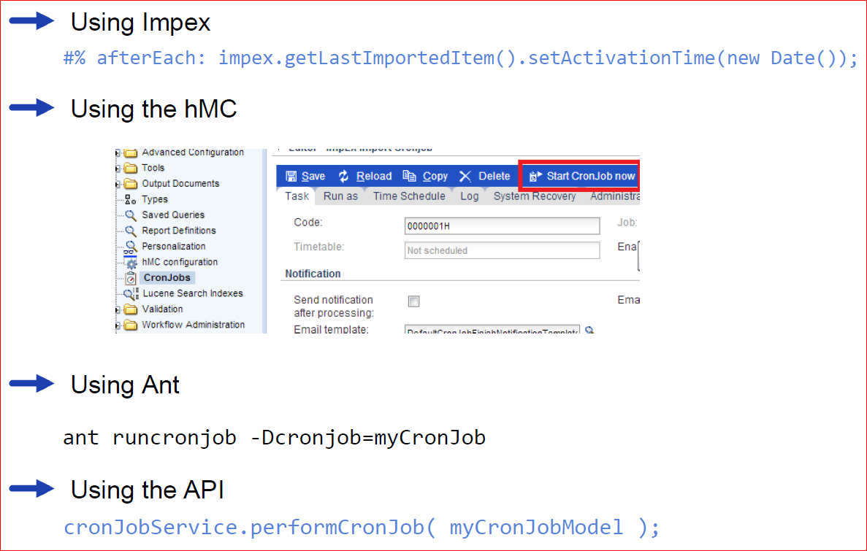
How to start a CronJob

Slide 8
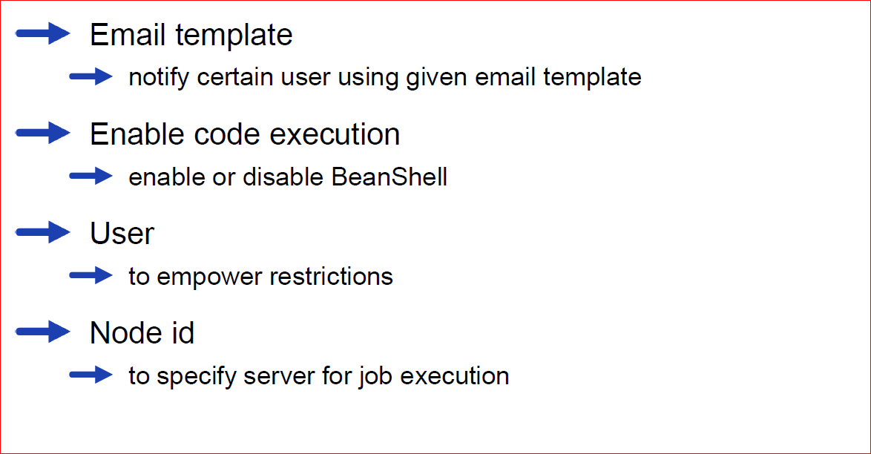
Useful CronJob properties

